Slide 1


AWS Administration service
Lesson 08: AWS Administration service
Notes:
Add instructor notes here.

Slide 2
Lesson Objectives
In this lesson, you will learn:
AWS IAM
Notes:
AWS IAM
This lesson is to give an Introduction on Java Server Pages

Slide 3

8.1: AWS IAM Amazon Administration Service
At AWS Cloud security is highly important.
The AWS cloud provides you with a platform to scale and innovate, while still maintaining a secure environment.
One can have the security when need, but without the upfront expenses, and at a lower cost than in an on-premises environment.
Different AWS services provides Security, Identity, and Compliance are
AWS Artifact
AWS certificate manager
AWS Key Management Service (KMS)
AWS Identity and Access Management (IAM)
Notes:
The AWS Artifact portal provides on-demand access to AWS' security and compliance documents, also known as audit artifacts.
AWS Certificate Manager is a service that lets you easily provision, manage, and deploy Secure Sockets Layer/Transport Layer Security (SSL/TLS) certificates.
AWS Key Management Service (KMS) is a managed service that makes it easy for you to create and control the encryption keys used to encrypt your data..

Slide 4
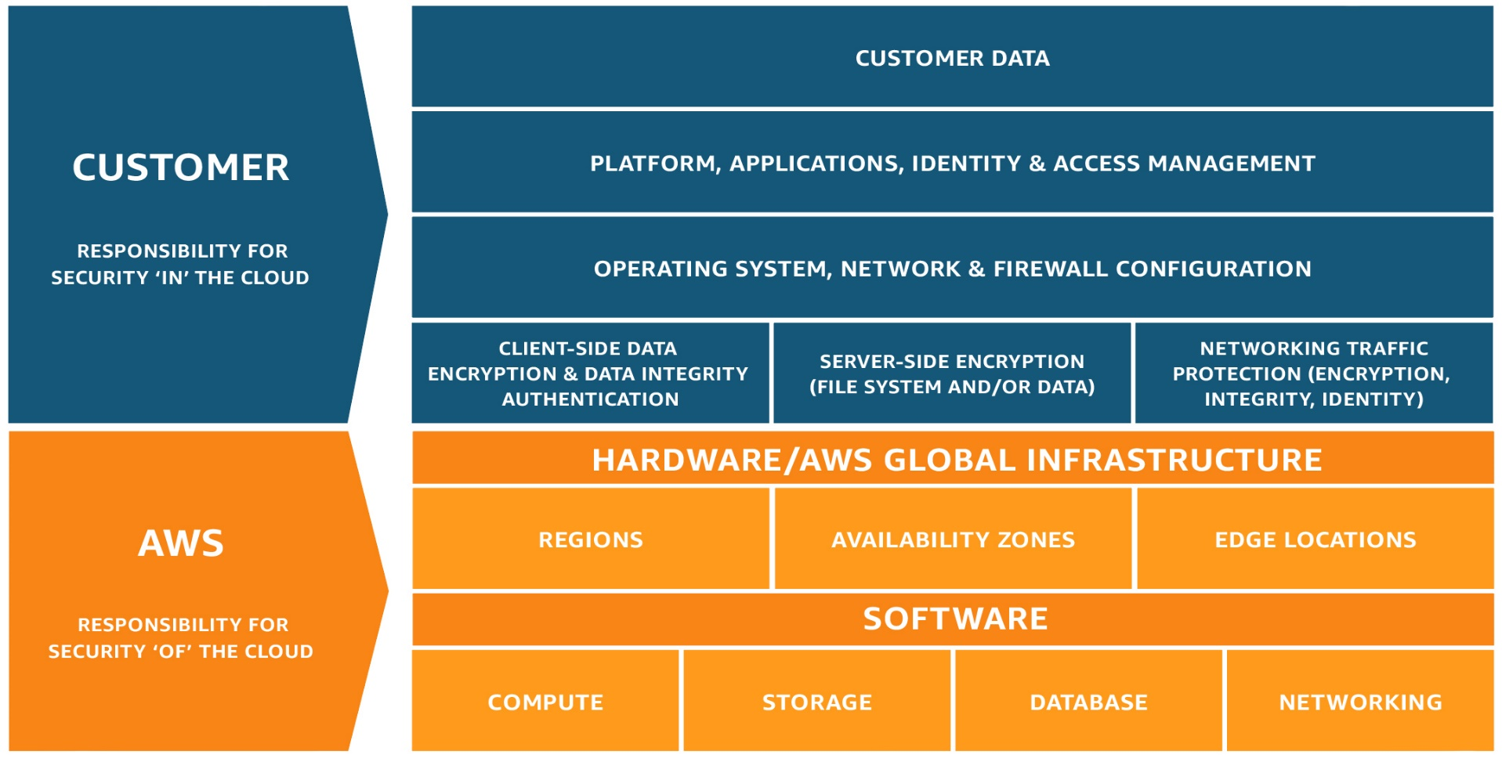
9.1: AWS IAM AWS Shared security model
Notes:
The AWS Developer Tools is a set of services designed to enable developers and IT operations professionals practicing DevOps to rapidly and safely deliver software. Together, these services help you securely store and version control your application's source code and automatically build, test, and deploy your application to AWS or your on-premises environment. You can use AWS CodePipeline to orchestrate an end-to-end software release workflow using these services and third-party tools or integrate each service independently with your existing tools.

Slide 5
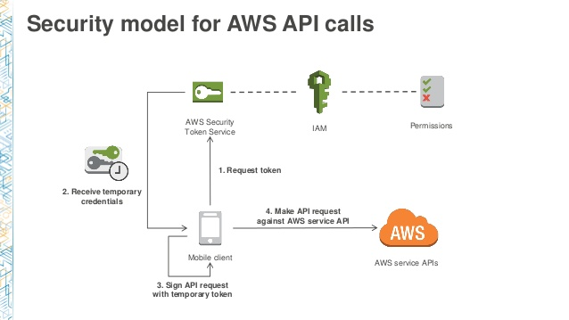
8.1: AWS IAM Amazon Development tool Service

Slide 6
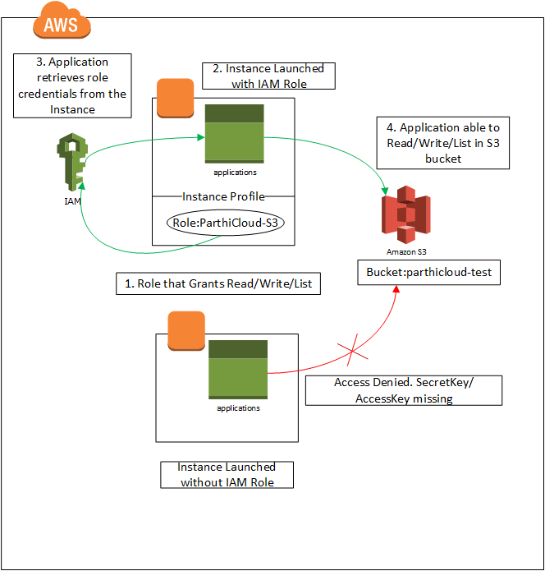
9.1: AWS IAM Amazon IAM
AWS Identity and Access Management (IAM) is an access management service for your AWS cloud resources.
Notes:
AWS Identity and Access Management (IAM) is an access management service for your AWS cloud resources.
It enables you to securely control access to AWS services and resources for your users.
One can create and manage AWS users and groups, and use permissions to allow and deny their access to AWS resources.
IAM is a feature of our AWS account which offered at no additional charge. You will be charged only for use of other AWS services by your users.

Slide 7
8.1: AWS IAM AWS IAM – Best practices
Users
Groups
Permissions
Auditing
Password
MFA(Multi-factor Authentication).
Notes:
Users – Create individual users.
Groups – Manage permissions with groups.
Permissions – Grant least privilege.
Auditing – Turn on AWS CloudTrail.
Password – Configure a strong password policy.
MFA – Enable MFA for privileged user

Slide 8
9.1: AWS IAM AWS IAM – Best practices
Roles
Sharing
Rotate
Conditions
Root
Notes:
Roles – Use IAM roles for Amazon EC2 instances.
Sharing – Use IAM roles to share access.
Rotate – Rotate security credentials regularly.
Conditions – Restrict privileged access further with conditions.
Root – Reduce or remove use of root.

Slide 9
8.1: AWS IAM AWS IAM – Use cases
Fine-grained access control to AWS resources
IAM enables our users to control access to AWS service APIs and to specific resources.
It also enables us to add specific conditions such as time of day to control how a user can use AWS, their originating IP address, whether they are using SSL, or whether they have authenticated with a multi-factor authentication device.
Multi-factor authentication for highly privileged users
Protect our AWS environment by using AWS MFA, a security feature available at no extra cost that augments user name and password credentials
Manage access control for mobile applications with Web Identity Providers
Integrate with your corporate directory
Conditions
Root
Notes:
You can enable your mobile and browser-based applications to securely access AWS resources by requesting temporary security credentials that grant access only to specific AWS resources for a configurable period of time.
IAM can be used to grant your employees and applications federated access to the AWS Management Console and AWS service APIs, using your existing identity systems such as Microsoft Active Directory. You can use any identity management solution that supports SAML 2.0, or feel free to use one of our federation samples (AWS Console SSO or API federation).

Slide 10
9.1: AWS IAM AWS IAM – Functionality
AWS IAM allows you to:
Manage IAM users and their access : ---
Manage IAM roles and their permissions
Manage federated users and their permissions
Notes:
You can create users in IAM, assign them individual security credentials (in other words, access keys, passwords, and multi-factor authentication devices), or request temporary security credentials to provide users access to AWS services and resources. You can manage permissions in order to control which operations a user can perform.
You can create roles in IAM and manage permissions to control which operations can be performed by the entity, or AWS service, that assumes the role. You can also define which entity is allowed to assume the role. In addition, you can use service-linked roles to delegate permissions to AWS services that create and manage AWS resources on your behalf.
You can enable identity federation to allow existing identities (users, groups, and roles) in your enterprise to access the AWS Management Console, call AWS APIs, and access resources, without the need to create an IAM user for each identity.

Slide 11
8.1: AWS IAM Demo
Demo on:
Amazon IAM ( Refer Steps in Note section )
Notes:
5.1. Create an EC2 instance.
Follow the Steps to create a user by using IAM service
Step 1: Choose the IAM service in AWS
Step 2 : Click on User link in IAM dashboard and click on AddUser button
Step 3 : Type a user name and choose both the access type
Step 4 : Select custom password and provide a password .( it must contain at least 12 characters and it must contain a digit )
Step 5 : click on Next permission button.
Step 6 : Click on Attach existing policy button directly
Step 7 : Select AmazonEC2ReadonlyAccess checkbox from existing list and click Next: review button.
Step 8 : click on create user button .
Step 9 : Now download the credential in .csv format and click on close button.
Step 10 : Click on user link and review the policy.

Slide 12
9.1: AWS IAM Demo
Demo on:
Amazon IAM (Refer Steps in Note section )
Notes:
Follow the Steps to create a policy for your Ec2 instance which you have created before.
Step 11 : Click on Policy link in IAM dashboard
Step 12 : Click on createpolicy button
Step 13 : Choose EC2 service.
Step 14 : Click on Select action link and choose List and read checkbox
Step 15 : Select resources and choose specific option
Step 16 : Click on Add ARN link
Step 17 : click on Add button
Step 18 : click on review policy button
Step 19 : click on Add permission link
Step 20 : choose IAM service
Step 21 : select Action and expand Write option
Step 22 : choose checkbox “Update Login Profile”
Step 23 : Now choose specific resources and add ARN
Step 24 : Click on review policy button
Step 25 : click on create policy button
Step 26 : go to user and select the user you created before
Step 27 : detach the previous policy
Step 28 : Add the policy you created before

Slide 13
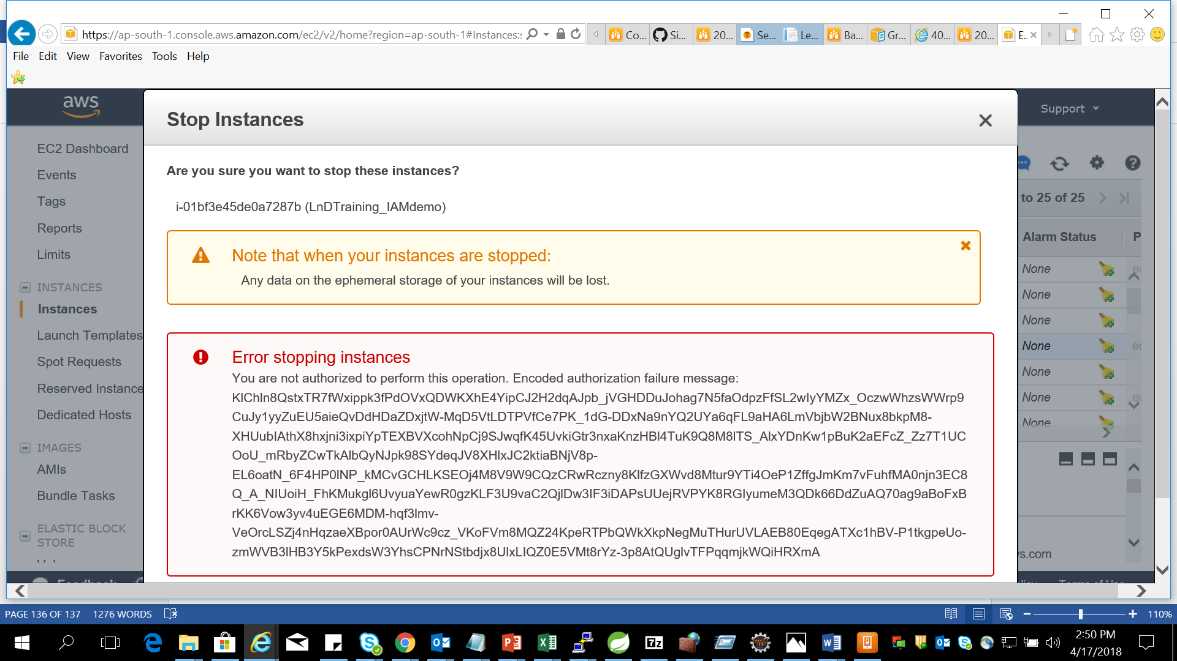
8.1: AWS IAM Demo
Demo on:
Amazon IAM (Refer Steps in Note section )
Notes:
Step 29: click on Next review button
Step 30 : check the new policy attached to user
Steps to allow the user top signin and see the restrictions
Step 31 : Go to browser and add the user name and password and login
Step 32 : Select EC2 service and see all the instances.
Step 33 : Choose your instance and try to stop it.

Slide 14
Summary
In this lesson, you have learnt:
AWS IAM

Slide 15
Review – Questions
Question 1: ________________ is a service that lets you easily provision, manage, and deploy Secure Sockets Layer/Transport Layer Security (SSL/TLS) certificates.
Question 2 : _____________ enables us to securely control access to AWS services and resources for our users.
Notes:
Answers for the Review Questions:
Answer 1: AWS Certificate Manager
Answer 2: AWS IAM

Slide 16
Review – Questions
Question 3: ________________ IAM best practice Manage permissions with groups.
Notes:
Answers for the Review Questions:
Answer 3: IAM Groups
Answer 2: AWS IAM

